Slide 1
Architecture Design
Instructor: Mehroze Khan

Slide 2
Achieving Quality Attributes
Reflect the characteristics that users want to see in the products we build.
Architectural styles provide general beneficial properties. Quality attributes also need to be supported:
Modifiability
Performance
Security
Reliability
Robustness
Usability
Business goals

Slide 3
Modifiability
Design must be easy to change
More than half of the full life-cycle cost of a system—including development, problem fixing, enhancement, and evolution—is spent after the first version of the software is developed and released, modifiability is essential.
Two classifications of affected software units:
Directly affected
Indirectly affected

Slide 4
Modifiability
Directly affected units’ responsibilities change to accommodate a system modification
Anticipate expected changes
Value cohesion
Maintain generality
Indirectly affected units’ responsibilities do not change, but implementations must be revised
Lower coupling
Interact through interfaces
Employ multiple interfaces
Notes:
A software unit is cohesive if its pieces, data, and functionality all contribute to the unit’s purpose and responsibilities.
Generality example: Server
The level of coupling among software units is the degree to which the units depend on each other.

Slide 5
Performance
Performance attributes describe constraints on system speed and capacity:
Response time: How fast does our software respond to requests?
Throughput: How many requests can it process per minute?
Load: How many users can it support before response time and throughput start to suffer?

Slide 6
Performance
Tactics for improving performance include:
Improve utilization of resources
Concurrency
Replicate and distribute shared data
Manage resource allocation more effectively
First-come/first-served: Requests are processed in the order in which they are received
Explicit priority: Requests are processed in order of their assigned priorities
Earliest deadline first: Requests are processed in order of their impending deadlines
Pre-emptive Scheduling: Lower-priority request is preempted in favor of a higher-priority request.
Round Robin: Allocates resources to requests for fixed time interval.
Reduce demand for resources
Notes:
For instance, multiple ATMs can simultaneously gather information about customers’ banking requests, authenticate the customers’ identification information, and confirm the requested transactions with the customers, before forwarding the requests to one of the bank’s servers. In this design, the server receives only authenticated and confirmed requests, which it can process
without further interaction with the customer, thereby increasing the server’s throughput.
However, if we replicate data, then we must also introduce mechanisms to keep the distributed copies in synch. The overhead of keeping data copies consistent must be more than offset by the performance improvements we gain from reducing data contention.
For example, if some of the system inputs are sensor data rather than requests for service, our software may be able to sample inputs at a lower frequency without the system’s missing important changes in the sensed environment.

Slide 7
Security
Two key architectural characteristics particularly relevant to security: immunity and resilience
Immunity: ability to thwart an attempted attack
The architecture encourages immunity by:
Ensuring all security features are included in the design
Minimizing exploitable security weaknesses
Resilience: ability to recover quickly and easily from an attack
The architecture encourages resilience by:
Segmenting functionality to contain attack
Enabling the system to quickly restore functionality

Slide 8
Reliability
A software system is reliable if it correctly performs its required functions under assumed conditions
Is the software internally free of errors?
A fault is the result of human error, compared to a failure, which is an observable departure from required behaviour
Software is made more reliable by preventing or tolerating faults

Slide 9
Reliability
Passive fault detection: wait until fault occurs during execution
Active fault detection: periodically check for symptoms or try to anticipate when failures will occur
Exceptions: situations that cause the system to deviate from its desired behaviour
Include exception handling in design to handle exception and return system to acceptable state
Typical exceptions include:
Failing to provide a service
Providing the wrong service
Corrupting data
Violating a system invariant (e.g.; security property)
Deadlocking

Slide 10
Reliability
Fault recovery: handling fault immediately to limit damage
Fault recovery tactics:
Undoing transactions: manage a series of actions as a single transaction that are easily undone if a fault occurs midway through the transaction
Checkpoint/rollback: software records a checkpoint of current state; rolls back to that point if system gets in trouble
Backup: system automatically substitutes faulty unit with backup unit
Degraded service: returns to previous state, offers degraded version of the service
Correct and continue: detects the problem (data consistency, stalled process) and treats the symptoms
Report: system returns to its previous state and reports the problem to an exception-handling unit

Slide 11
Robustness
A system is robust if it includes mechanisms for accommodating or recovering from problems in the environment or in another unit
Mutual suspicion: each software unit assumes that the other units contain faults
Robustness tactics differ from reliability tactics because the source of problems is different
Recovery tactics are similar:
Rollback to checkpoint state
Abort a transaction
Initiate a backup unit
Provide reduced service
Correct symptoms and continue processing
Trigger an exception

Slide 12
Usability
Usability reflects the ease with which a user is able to operate the system
User interface should reside in its own software unit
Some user-initiated commands require architectural support
There are some system-initiated activities for which the system should maintain a model of its environment
Notes:
The user interface should reside in its own software unit, or possibly its own architectural layer. This separation makes it easier to customize the user interface for different audiences, such as users of different nationalities or different abilities.
Second, there are some user-initiated commands that require architectural support. These include generic commands such as cancel, undo, aggregate, and show multiple views. At a minimum, the system needs a process that listens for these commands, because they could be generated at any time, unlike user commands that are input in response to a system prompt. In addition, for some of these commands, the system needs to prepare itself to receive and execute the command. For example, for the undo command, the system must maintain a chain of previous states to
which to return. For the show multiple views command, the system must be able to present multiple displays and keep them up-to-date and consistent as data change. In general, the
design should include facilities for detecting and responding to any expected user input.
For example, a pacemaker can be configured to trigger a heartbeat 50, 60, or 70 times a minute, and an accounting system can be set up to generate monthly paychecks or bills automatically. The system must track the passage of time or days to be able to initiate such time-sensitive tasks.

Slide 13
Business Goals
Business Goals are quality attributes the system is expected to exhibit (e.g., minimizing the cost of development and time to market)
Buy vs. Build
Save development time, money
More reliable
Existing components create constraints; vulnerable to supplier
Initial development vs. maintenance costs
Save money by making system modifiable
Increased complexity may delay release; lose market to competitors
New vs. known technologies
Acquiring expertise costs money, delays product release
Either learn how to use the new technology or hire new personnel
Eventually, we must develop the expertise ourselves
Notes:
It can also make our system vulnerable to the availability of the component’s supplier and can be disastrous if the supplier goes out of business or evolves the component so that it is no longer compatible with our hardware, software, or needs.
Many of the architectural styles and tactics that promote modifiability also increase a design’s complexity, and thus increase the system’s cost. Because more than half of a system’s total development costs are incurred after the first version is released, we can save money by making our system more modifiable. However, increased complexity may delay the system’s initial release. During this delay, we collect no payment for our product, we risk losing market share to our competitors, and we risk our reputation as a reliable software supplier. Thus, for each system that we build, we must evaluate the tradeoff between early delivery and easier maintenance.

Slide 14
Architecture Evaluation and Refinement
Design is iterative: we propose design decisions, assess, make adjustments, and propose more decisions
Many techniques to evaluate the design:
Trade-off analysis
Cost-benefit analysis

Slide 15
Trade-off Analysis
Often, there are several alternative designs to consider:
As professionals, it is our duty to explore design alternatives and not simply implement the first design that comes to mind.
It may not be immediately obvious which architectural styles to use as the basis for a design if the design is expected to achieve quality attributes that conflict with one another.
Different members of our design team may promote competing designs, and it is our responsibility to decide which one to pursue.
Need a measurement-based method for comparing design alternatives, so that we can make informed decisions and can justify our decisions to others.

Slide 16
Trade-off Analysis One Specification, Many Designs
To see how different architecture styles can be used to solve the same problem.
The [key word in context] KWIC system:
Accepts an ordered set of lines.
Each line is an ordered set of words.
Each word is an ordered set of characters.
Any line may be “circularly shifted” by repeatedly removing the first word and appending it at the end of the line.
The KWIC index system outputs a list of all circular shifts of all lines in alphabetical order.
Such systems are used to index text, supporting rapid searching for keywords. For example, KWIC is used in electronic library catalogues (e.g., find all titles that contain the name “Martin Luther King Jr.”) and in online help systems (e.g., find all index entries that contain the word “customize”).

Slide 17
Trade-off Analysis One Specification, Many Designs
Shaw and Garlan (1996) present four different architectural designs to implement KWIC:
Repository
Data abstraction
Implicit invocation (a type of publish-subscribe),
Pipe-and-filter.

Slide 18
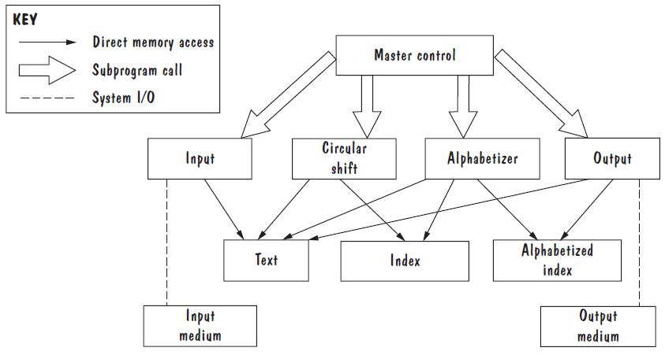
Trade-off Analysis One Specification, Many Designs
Shared data solution for KWIC

Slide 19
Trade-off Analysis One Specification, Many Designs
Repository Solution.
Breaks the problem into its four primary functions: input, circular shift, alphabetizer, and output.
Four modules are coordinated by a master program that calls them in sequence.
Data are localized in their own modules, and not replicated or passed among the computational modules, the design is efficient.
Design is difficult to change because the computational modules access and manipulate the data directly, via read and write operations, any change to the data and data format will affect all modules.
None of the elements in the design are particularly reusable.

Slide 20
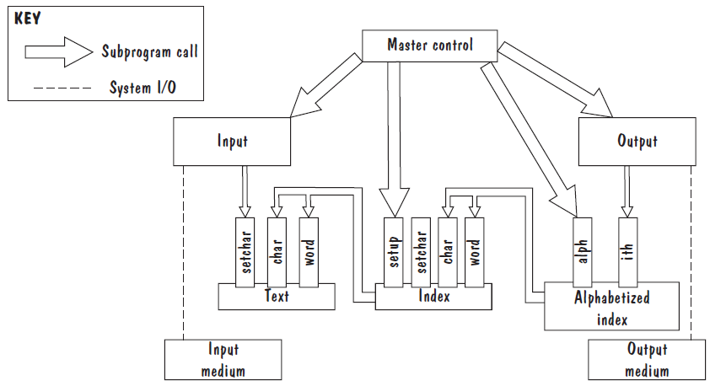
Trade-off Analysis One Specification, Many Designs
Alphabetic Shift Module
Circular Shift Module
Data-module solution for KWIC

Slide 21
Trade-off Analysis One Specification, Many Designs
Data Abstraction Solution.
Second design has a similar decomposition of functionality into sequentially called modules.
In this design, the data computed by each computational module is stored in that module.
Circular-shift module maintains the index to keywords in the text.
Alphabetic-shift module maintains a sorted (alphabetized) version of this index.
Each module’s data are accessible via access methods, rather than directly. Thus, the modules form data abstractions.
Data-abstraction modules encompass both the data to be maintained and the operations for maintaining the data, these modules are easier to reuse in other applications than modules from our first design.
On the downside, changes to the system’s functionality may not be so easy, because the functionality is so tightly coupled with the data.
Notes:
On the downside, changes to the system’s functionality may not be so easy, because the functionality is so tightly coupled with the data. For example, omitting indices whose circular shifts start with noise words means either (1) enhancing an existing module, making it more complex, more context specific, and less reusable; or (2) inserting a new module to remove useless indices after they have been created, which is inefficient, and modifying existing modules to call the new module

Slide 22
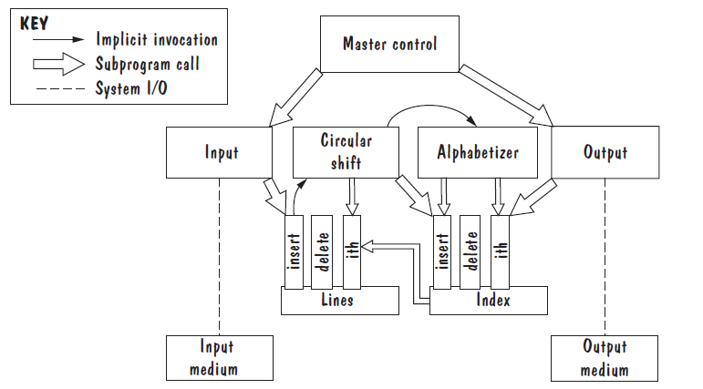
Trade-off Analysis One Specification, Many Designs
ADT solution for KWIC

Slide 23
Trade-off Analysis One Specification, Many Designs
Implicit Invocation Solution.
Data are stored in ADTs that manage generic data types, such as lines of text and sets of indices, rather than in KWIC-based data abstractions.
Many of the computational modules are triggered by the occurrence of events rather than by explicit procedure invocation. For example, the circular-shift module is activated whenever a new line of text is input.
ADTs are generic, they are even more reusable than data abstractions.
Data and operations on data are encapsulated in the ADT modules, so changes to data representation are confined to these modules.
The design can be easily extended, via new computational modules whose methods are triggered by system events; existing modules do not need to be modified to integrate the new modules into the system.
One complication with an implicit-invocation design is that multiple computational methods may be triggered by the same event. If that happens, all the triggered methods will execute, but in what order?
Notes:
If we do not impose an order, then the triggered methods may execute in any arbitrary order, which may not be desired (e.g., a method that expands macros in new lines of text should execute before a method that inserts a new line into the ADT). However, to control execution order, we must devise some generic strategy that applies to both current and future sets of methods triggered
by the same event, and we cannot always predict what methods may be added to the system in the future.

Slide 24
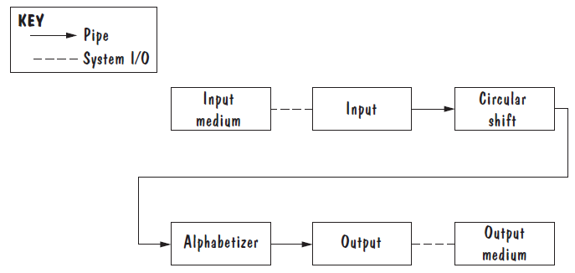
Trade-off Analysis One Specification, Many Designs
Pipe-and-Filter solution for KWIC

Slide 25
Trade-off Analysis One Specification, Many Designs
Pipe-and-Filter Solution.
Sequence of processing is controlled by the sequence of the filter modules.
This design is easily extended to include new features, in that we can simply insert additional filters into the sequence.
The filters may execute in parallel, processing inputs as they are received; this concurrent processing can enhance performance.
There are some space inefficiencies: circular shifts can no longer be represented as indices into the original text and instead are permuted copies of the original lines of text.
Data item is copied each time a filter outputs its results to the pipe leading to the next filter.

Slide 26
Trade-off Analysis One Specification, Many Designs
Each design has its positive and negative aspects.
Need a method for comparing different designs that allows us to choose the best one for our purpose.

Slide 27
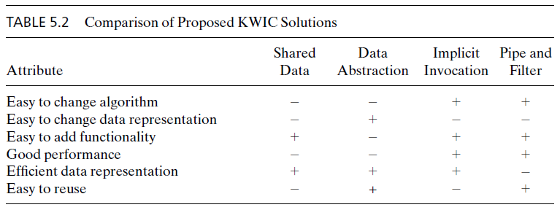
Trade-off Analysis One Specification, Many Designs (Comparison Tables)
A plus means that the design has the attribute
A minus means that the design does not have the attribute
Notes:
Compare the four designs according to how well they achieve important quality attributes and then organize this information as a table.
We can see from the table that the choice is still not clear; we must assign priorities to the attributes and form weighted scores if we want to select the best design for our particular needs.

Slide 28
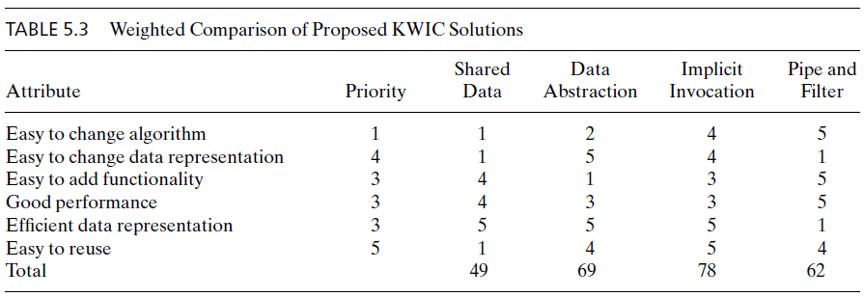
Trade-off Analysis One Specification, Many Designs (Comparison Tables)
Highest Priority of an attribute = 5, Lowest priority = 1. For example, Reusability could be the most desirable attribute
Numbers in column 3 to 6 represent the extent to which a design satisfies the characteristic of the corresponding attribute. 1 being the lowest, 5 being the highest

Slide 29
Trade-off Analysis One Specification, Many Designs (Comparison Tables)
Multiply the priorities with ratings and sum over the design to get score for each design
For example, score for pipe and filter = 1x5 + 4x1 + 3x5 + 3x5 + 3x1 + 5x4 = 62.
Pick the design with the highest score. In this case, Implicit-Invocation design is chosen

Slide 30
Trade-off Analysis One Specification, Many Designs
Other attributes to consider
Modularity
Testability
Security
Ease of use
Ease of understanding
Ease of integration

Slide 31
Cost-Benefit Analysis
Will the benefits of a system based on a particular design outweigh the costs of its implementation?
If there are competing designs, which one will give us the highest return on investment?
Notes:
Trade-off analysis gives us a means for evaluating design alternatives, but it focuses only on the technical merits of designs, in terms of how well the designs achieve desired quality attributes. At least as important are the business merits of a design

Slide 32
Cost-Benefit Analysis
Consider a proposal to improve KWIC performance because the number of KWIC indices have increased
Eliminate noise word indices?
Change representation of indices to bin of indices?
Increase server capacity by adding another computer?
A cost–benefit analysis is a widely used business tool for estimating and comparing the costs and benefits of a proposed change
Notes:
We could eliminate entries in the KWIC index that start with noise words, such as articles (“a, the”) and prepositions. This change reduces the number of indices to be searched when servicing lookup query. It would involve adding a filter module, between the circular-shift and sorted-indices modules, that aborts any request to store an index to a noise word.
We could change the representation of indices to be bins of indices, where each bin associates a keyword with the set of indices that point to lines that contain that word. This change reduces the time it takes to find subsequent instances of a keyword once the first instance (i.e., the bin) has been found.
We could increase server capacity by adding another computer, Query Processor 2, that shares the task of processing queries. This change involves not only buying the server, but also changing the software architecture to include a Dispatcher module that assigns queries to servers.

Slide 33
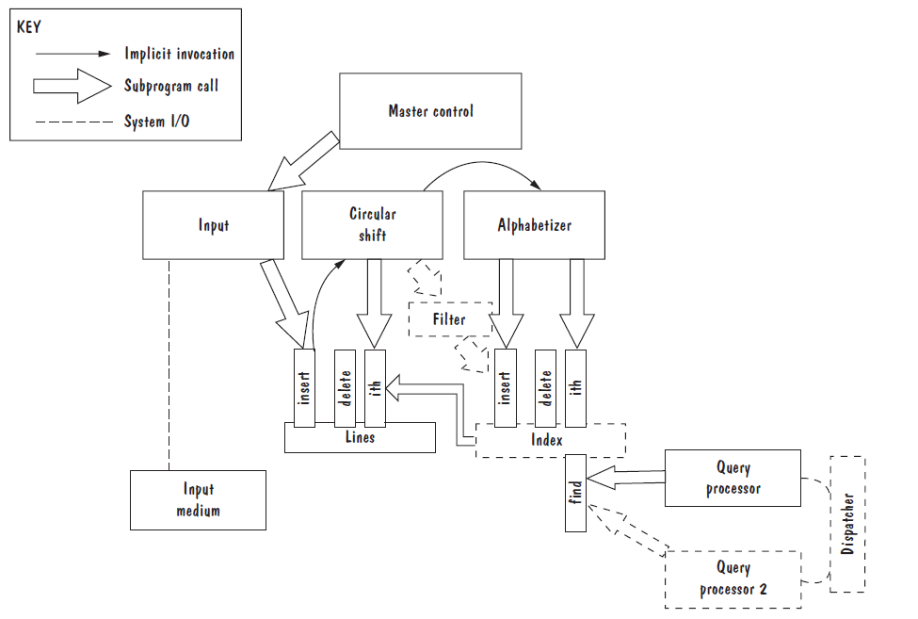
Cost-Benefit Analysis (Proposed Changes to KWIC)

Slide 34
Cost-Benefit Analysis (Computing Benefits)
A cost-benefit analysis contrasts financial benefits with financial costs, both in Dollars
Costs
Development
Operational
Benefits
Reduced Operational Costs
Increased Earnings
Notes:
Computing Benefits. A cost–benefit analysis usually contrasts financial benefits with financial costs. Thus, if the benefit of a design is in the extra features it provides, or in the degree to which it improves quality attributes, then we must express these benefits as a financial value. Costs are often one-time capital expenses, with perhaps some ongoing operating expenses, but benefits almost always accrue over time. Thus, we calculate benefits over a specific time period, or calculate the time it would take for benefits to pay for the costs.

Slide 35
Cost-Benefit Analysis (Computing Benefits)
Suppose that the current catalogue contains 70,000 entries, and that the average size of an entry (i.e., the number of words per record, including the video’s title, the director’s name, the actors’ names, and so on) is 70 words, for a total of almost five million circular shifts.
On average, it currently takes the system 0.016 seconds to find and output all entries that contain two keywords, which means that the system accommodates about 60 such requests per second.
However, at peak times, the system will receive up to 100 queries per second, and the system is eventually expected to handle 200 queries per second.

Slide 36
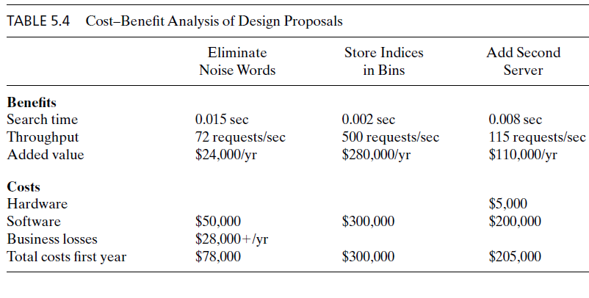
Cost-Benefit Analysis

Slide 37
Cost-Benefit Analysis
For simplicity, suppose that every additional request per second that the system can process, up to 200 requests/second, would save the company $2000 per year, based on retained customers and reduced calls to technical support.
Given this value function, eliminating noise words would save the company $24,000 per year, calculated as:
(72 requests/second - 60 requests/second) * $2000/year = $24,000/year
Adding a second server would save the company $110,000 per year, calculated as:
(115 requests/second - 60 requests/second) * $2000/year = $110,000/year
The second design option would improve the system’s throughput beyond what will be needed (the system will receive at most 200 requests per second).Therefore, the value added by changing to bin-based indexing is the maximum possible value:
(200 requests/second - 60 requests/second) * $2000/year = $280,000/year

Slide 38
Cost-Benefit Analysis
Payback period
length of time before accumulative benefits recover the costs of implementation
In this example, the payback period for restructuring the sorted-index module (design 2) is:
$300,000/$280,000 = 1.07 of a year = approximately 13 months

Slide 39
Cost-Benefit Analysis
Return on Investment (ROI)
An ROI of 1 or greater means that the design’s benefits outweigh its costs. The higher the ROI value, the more effective the design.
ROI = Benefits/Cost, ROI > 1 is desired
%age gain ROI = (Benefits – Cost) / Cost x 100
Example
After five years
Cost = $ 2249559
Benefits = $ 6122893
ROI = 2.72 i.e. Total benefits are approx. 3 times the total costs
%age gain ROI = 172.19 % i.e. Your earnings are 172.19 % of the total costs

Slide 40
Trade-off Analysis (Exercise) One Specification, Many Designs (Comparison Tables)
Attribute | Priority | Design A | Design B | Design C | Design D
Good Performance | 3 | 3 | 2 | 5 | 4
High Security | 5 | 3 | 5 | 4 | 4
Modularity | 4 | 5 | 1 | 3 | 1
Ease of Integration | 1 | 1 | 3 | 5 | 5
Easy to Reuse | 2 | 2 | 1 | 4 | 3
Total |  | ? | ? | ? | ?
Highest Priority of an attribute = 5, Lowest priority = 1
Calculate the score of each design.
Which Design will be chosen?

Slide 41
Trade-off Analysis (Exercise Solution) One Specification, Many Designs (Comparison Tables)
Attribute | Priority | Design A | Design B | Design C | Design D
Good Performance | 3 | 3 | 2 | 5 | 4
High Security | 5 | 3 | 5 | 4 | 4
Modularity | 4 | 5 | 1 | 3 | 1
Ease of Integration | 1 | 1 | 3 | 5 | 5
Easy to Reuse | 2 | 2 | 1 | 4 | 3
Total |  | 49 | 40 | 60 | 47
Which Design will be chosen?
Answer: Design C

